Slide 1
How Well Do Neurologic Symptoms Identify Individuals with Neurosyphilis?
Arielle Davis, Joshua Stern, Shelia Dunaway, Lauren Tantalo, Sharon Sahi, Abigail Crooks, Claire Stevens, Sarah Holte, Christina Marra
April 19, 2018

Slide 2
No conflicts of interest or relationships to disclose.

Slide 3
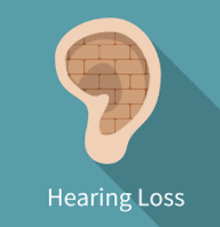
Natural Hx of Neurosyphilis
Continuum 2015; 21(6): 1714-1728.

Slide 4
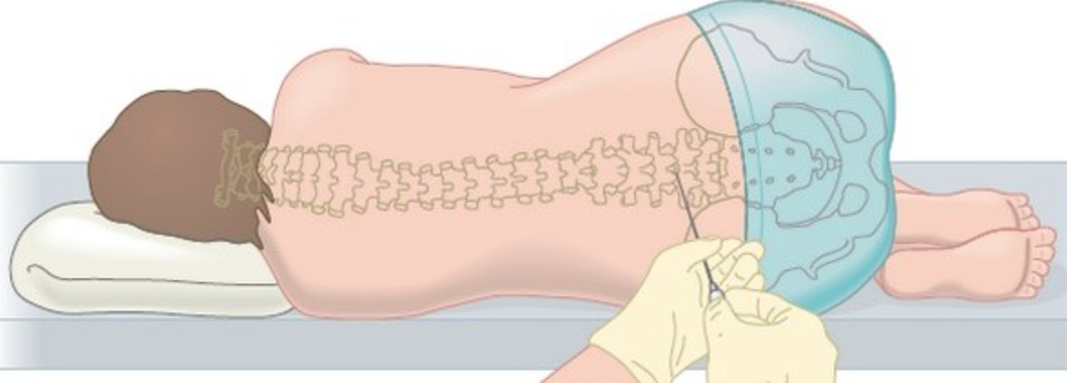
CDC Guidelines
Lumbar puncture (LP) in syphilis patients with:
Cranial nerve dysfunction
Meningitis
Stroke
Altered mental status
Loss of vibration sense
Vision loss
Hearing loss
Workowski KA, Bolan GA, Centers for Disease C, Prevention. Sexually transmitted diseases treatment guidelines, 2015. MMWR Recomm Rep 2015;64:1-137.

Slide 5
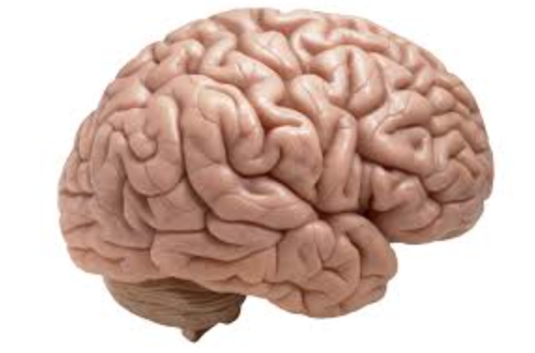
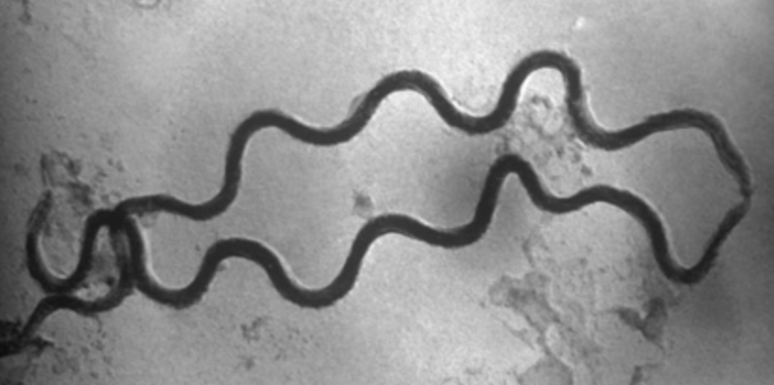
Are certain neurologic symptoms more predictive of neurosyphilis (NS) than others?

Slide 6
Methods: Prospective Study of CSF Abnormalities in Syphilis
Entry
Criteria
Untreated Syphilis
Concern by referring provider for NS
Procedures
Standardized assessment of new symptoms
Venipuncture & LP
NS rigorously defined as a reactive CSF-VDRL
none-mild-moderate-severe
Neuro sx
RPR ≥ 1:32*
CD4 ≤ 350/μl*
*Marra CM, Maxwell CL, Smith SL, et al. Cerebrospinal fluid abnormalities in patients with syphilis: association with clinical and laboratory features. J Infect Dis 2004; 189(3): 369-76.

Slide 7
Methods: Clinical Symptoms Assessed
Headache
Stiff neck
Photophobia
Gait incoordination
Vision loss
Ocular inflammation
Hearing loss
Sensory loss
(Tinnitus)
Mild or greater severity
Moderate or greater severity
Moderate or greater severity

Slide 8
Participant Characteristics
 | n (%) or median (IQR) |  | P-value
 | HIV- n=81 | HIV+ n=385
Men | 67 (83%) | 383 (99%) | <0.001
Age (years) | 39 (30-52) | 39 (33-45) | NS
Early syphilis | 34 (42%) | 266 (69%) | <0.001
1/Serum RPR titer | 64 (4-128) | 64 (16-256) | 0.002
≥1 mild symptom | 65 (81%) | 295 (79%) | NS
CSF-VDRL reactive | 20 (25%) | 68 (18%) | NS
Notes:
There were a total of 466 individuals included in the analysis and reflecting the demographics of syphilis in Seattle, the majority were HIV-infected 385 and the majority were middle-aged men. HIV-infected participants were more likely to have early syphilis (primary, secondary or early latent disease) 69% in HIV+ vs 42% in HIV-. The median RPR titer in both groups was 1:64 but with a higher IQR in the HIV-infected. Most participants had at least 1 clinical symptom, and by our rigorous def of NS which again was defined as a reactive CSF VDRL, 25% of the HIV uninfected and 18% of the HIV infected had neurosyphilis.

Slide 9
Neurologic Symptoms Reported
Clinical Symptom | HIV- n (%) | HIV+ n (%) | P-value
Headache | 27 (33%) | 149 (39%) | NS
Stiff neck | 12 (15%) | 59 (16%) | NS
Photophobia | 13 (16%) | 64 (17%) | NS
Vision loss | 44 (56%) | 179 (48%) | NS
Ocular inflammation | 19 (24%) | 80 (21%) | NS
Hearing loss | 24 (31%) | 63 (17%) | 0.006
Sensory loss | 7 (9%) | 14 (4%) | 0.047
Gait incoordination | 21 (26%) | 63 (17%) | 0.041
Notes:
As I already said most study participants had at least one of the neurologic symptoms that were assessed. Only 19% of the HIV uninfected and 20% of the HIV infected participants endorsed none of the symptoms. The most common symptoms in the HIV uninfected were in order of prevalence: vision loss, headache and hearing loss vs in the HIV infected vision loss, headache, and ocular inflammation. Compared to the HIV-infected, the HIV-uninfected were more likely to have hearing loss, sensory loss, or gait incoordination (as you can see with the significant p-values).

Slide 10
Results: Associations Between Symptoms and Neurosyphilis (Reactive CSF-VDRL)
Symptom | Odds Ratios (95% CI)
 | HIV- | HIV+
≥Mild photophobia | 0.5 | 2.0 (1.1-3.8)*
≥Mild gait incoordination | 1.3 | 2.4 (1.3-4.4)**
≥Mild vision loss | 1.6 | 2.3 (1.3-4.1)**
≥Moderate vision loss | 2.3 | 6.7 (3.5-12.9)***
≥Moderate hearing loss | 0.6 | 3.1 (1.3-7.5)*
*P<0.05, **P<0.01, ***P<0.001
Notes:
When we then looked at which symptoms were associated with neurosyphilis, as defined by a reactive CSF VDRL, these were the symptoms that were important at least in the HIV infected. As you can see in the HIV-uninfected, none of the clinical sx were more common in those with neurosyphilis as defined by a reactive CSF-VDRL. In the HIV-infected the odds of NS were roughly 2x higher with mild or greater photophobia, gait incoordination, and vision loss, the strongest assoc was with mod+ VL with an odds ratio of 6.7, followed by mod+ HL with a 3.1x higher odds of NS.

Slide 11
Results: Specificity and Sensitivity of Neurologic Symptoms for Diagnosis of Neurosyphilis in HIV
 | Specificity | Sensitivity
≥Mild photophobia | 85% | 27%
≥Mild gait incoordination | 86% | 28%
≥Mild vision loss | 56% | 65%
≥Moderate vision loss | 92% | 38%
≥Moderate hearing loss | 95% | 13%
Notes:
We also looked at the specificity and sensitivity of the neurologic sx found to be associated with NS in the HIV infected participants, and as you can see, while these symptoms (w/ the exception of mild vision loss) had reasonable specificity, ranging from 85-95% for the dx of NS, the sensitivity was quite low, ranging from only 13-65%. Bottom line from these results is that you can’t use these symptoms as a screen for whom to tap b/c generally a high sensitivity test is good for a screening evaluation, but if your pt does have one of these symptoms, b/c they are relatively specific, it heightens your suspicion that the pt will have NS.
(And just to make the clinical significance clearer lets take the ex of mod or greater hearing loss – b/c specificity= the proportion of true negatives (those w/o NS) identified by the symptom, a specificity of 95% based on this sample, means that 95% of those withOUT NS would not having mod+HL and b/c sensitivity = the proportion of true positives (+NS) identified by the symptom, a sensitivity of 13% means based on this sample we’d expect 13% of pts with NS to have mod+ HL.)

Slide 12
Conclusions
Specific neurologic symptoms in HIV+ with syphilis predict neurosyphilis
Mild or greater photophobia
Mild or greater gait incoordination
Mild or greater vision loss
Moderate or greater hearing loss

Slide 13
Conclusions
Neurologic symptoms do not predict a reactive CSF-VDRL in HIV-
Smaller n in HIV- group
Notes:
However, neurologic sx do NOT predict NS in the HIV uninfected. Why? This was not a result we anticipated and possible reasons might include --

Slide 14
Conclusions
Neurologic symptoms do not predict a reactive CSF-VDRL in HIV-
CSF abnormalities may be more common in symptomatic neurosyphilis in HIV+ versus HIV-
Lee SY, Cheng V, Rodger D, Rao N. Clinical and laboratory characteristics of ocular syphilis: a new face in the era of HIV co-infection. J Ophthalmic Inflamm Infect 2015; 5(1): 56.
Notes:
Among pts with symptomatic NS, is coexisting meningitis (CSF abnormalities) just more common in those who are HIV-infected vs HIV-uninfected? This is supported by other work, particularly w/ the example of ocular syphilis…. A review of 93 HIV-infected and 50 HIV-uninfected individuals with syphilitic uveitis found that HIV infected ind were 1.3 x more likely to have CSF abnl than those not infected w/ HIV.

Slide 15
Conclusions
Lack of symptoms does not ensure a negative CSF-VDRL, regardless of HIV status
Remember asymptomatic neurosyphilis
Most STDs show no symptoms
Notes:
And finally given the low sensitivity of even our significantly associated sx, it is important to keep in mind that lack of sx…
The explanation for this is likely b/c of asymptomatic neurosyphilis… as we said at the beginning of the talk, we know that a subset of patients has a reactive CSF-VDRL even though the pt has no clinical symptoms. Asymptomatic NS is common, especially in early syphilis and the clinical significance remains a matter of debate.

Slide 16
Large sample size
Systematic assessment of clinical symptoms
Pragmatic
Limitations
Low number of HIV-
Multiple comparisons
Definition of NS
Did not assess cognitive complaints
Strengths
Notes:
Multiple comparisons make it more likely you will find an association that isn’t truly significant.

Slide 17
Acknowledgments
PI: Christina Marra, MD
This work was supported by NIH/NINDS NS34235

Slide 18
Questions?

