Slide 1
U=U
Julie Dombrowski, MD, MPH
Associate Professor of Medicine,
University of Washington
Deputy Director, HIV/STD Program
Public Health – Seattle & King County
Last updated 5/29/2018

Slide 2
Research supported by grants to UW from Hologic, ELITech, Quidel, Curatek Speaker honoraria from PRIME, WA DSHS, thebody.com Travel support to a meeting sponsored by Gilead

Slide 3
Undetectable = Untransmittable (U=U)
Review of the science: 3 key studies
Evolution of the slogan
Counseling patients

Slide 4
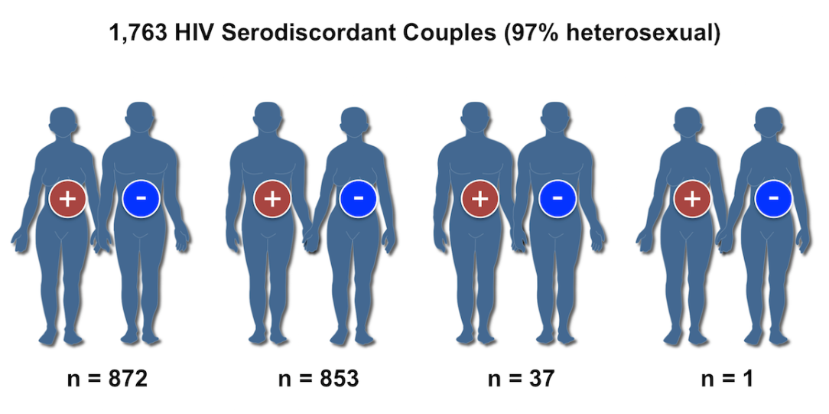
HPTN 052: HIV Treatment as Prevention
Stable, sexually active couples with CD4 350-550 cell/mm³
Primary outcome: virologically-linked partner infections
Randomized
Early ART
CD4 350-550
Delayed ART
CD4 ≤250
Cohen et al, NEJM 2016; National HIV Curriculum (graphic)

Slide 5
HPTN 052: HIV Treatment as Prevention
New HIV infections
(N=39)
Linked
(N=28)
Unlinked
(N=11)
Delayed
arm
27
Immediate arm
1
Occurred prior to viral suppression
96% reduction in transmission
Cohen et al, NEJM 2016

Slide 6
PARTNER Study “Partners of People on ART – A New Evaluation of the Risks”
Observational study of serodiscordant couples with HIV+ partner on ART to evaluate the risk of transmission
888 couples in primary analysis
(38% MSM)
58,000 condomless sex acts
17% of HIV- MSM
18% of HIV+ MSM
Had STI during f/u
11 new infections
0 linked transmissions
Rate of within-couple transmission =
0 (95% CI: 0-0.30/100 couple-years)
Rodger et al, JAMA 2016

Slide 7
Opposites Attract
Observational study of MSM sero-discordant couples in Australia, Thailand, Brazil
358 couples
591 couple-years f/u
16,889 condomless anal intercourse acts
12% of HIV- MSM
14% of HIV+ MSM
Had STI during f/u
3 new infections
0 linked transmissions
Rate of within-couple transmission =
0 (95% CI: 0-0.62/100 couple-years)
Grulich A, et al, IAS 2017

Slide 8
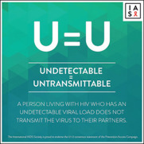
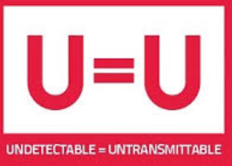
Evolution of U=U
Vancouver BC STOP Campaign
Swiss Statement
Swiss National AIDS Commission statement to doctors
PARTNER
No transmissions from MSM on ART
2010
2013
2016
2018
2011
2017
2008
2009
2012
2014
2015
Opposites Attract
HPTN 052 stopped early
Endorsed by 600 organizations from 75 countries
US Treatment Guidelines recommend ART for all persons living with HIV

Slide 9
Public Health – Seattle & King County Annual PRIDE Survey
Do you think HIV-positive people who take medicine to treat HIV are less likely to give HIV to their sex partners?
Percent answered “Yes”
Public Health – Seattle & King County Program Data

Slide 10
Trends in HIV and STDs in King County
STI | Trend
Syphilis | ↑195%
Urethral GC | ↑237%
Urethral CT | ↑114%
HIV | ↓37%
Diagnoses per 1000 MSM*
Year
* Assumes 5.7% men are MSM
PHSKC HIV/STD Program Data

Slide 11
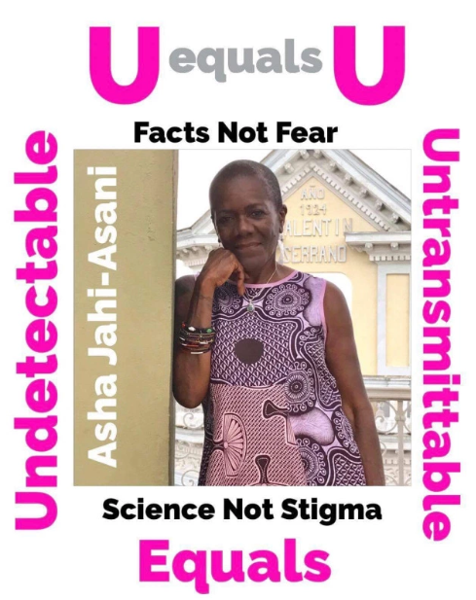
U=U Combats Stigma

Slide 12
Counseling Patients
U=U is a big change in messaging
For decades, condom use was the goal standard (90-95% effective in HIV prevention when used consistently)
Some providers and public health officials focus on the caveats
Clear messages are important for patients and public health campaigns
“People living with HIV on ART with an undetectable viral load in their blood have a negligible risk of sexual transmission of HIV...”
“NEGLIGIBLE” = so small or unimportant as to be not worth considering; insignificant.
-U-U Consensus Statement (www.preventionaccess.org)
“…This means that people who take ART daily as prescribed and achieve and maintain an undetectable viral load have effectively no risk of sexually transmitting the virus to an HIV-negative partner”
-CDC Dear Colleague Letter, Sept. 2017

Slide 13
Examples of U=U Risk Messaging
Term Used | Source
“Cannot transmit” | US Dept. of Veterans Affairs website
“Effectively no risk” | CDC, NIH
“From a practical standpoint, the risk is zero” | Anthony Fauci, NIAID director in interview
“No longer infectious” “No risk for HIV transmission” “Cannot be passed on” | Dr. Julio Montaner
“Cannot transmit” “Zero chance” | Lancet editorial
“Do not transmit” | IAS, NY State DOH, NASTAD etc
“Can’t pass it on” | Several public health campaigns
Document available on Prevention Access Campaign website

Slide 14
Counseling Patients: My View
Patients deserve to know the information
Knowing U=U can make a big difference in how people feel about themselves
Key Messages:
People with undetectable viral loads don’t transmit HIV
3 things prevent HIV transmission: viral suppression, PrEP, condoms
You and your partner(s) need to decide the right mix of those 3. Some people are comfortable with X, others decide to do Y
Two things to remember if you aren’t using condoms every time:
You need to take your medications regularly and check your viral load to make sure it stays undetectable
You are at risk for STDs like syphilis and gonorrhea. You need to get screened every 3 months & come in quickly if you have symptoms (discuss symptoms of syphilis)

Slide 15
Thank you

